Slide 1
Chess Game

Slide 2
Functions
Player Verses AI
Difficulty(3 Levels) for AI
Hosting on firebase
References

Slide 3
Collection of moves

Slide 4
Position evaluation

Slide 5
Minimax algorithm

Slide 6
Minimax algorithm Cont.
More information you can see it at https://en.wikipedia.org/wiki/Alpha%E2%80%93beta_pruning
or watch a video alpha beta prunning

Slide 7
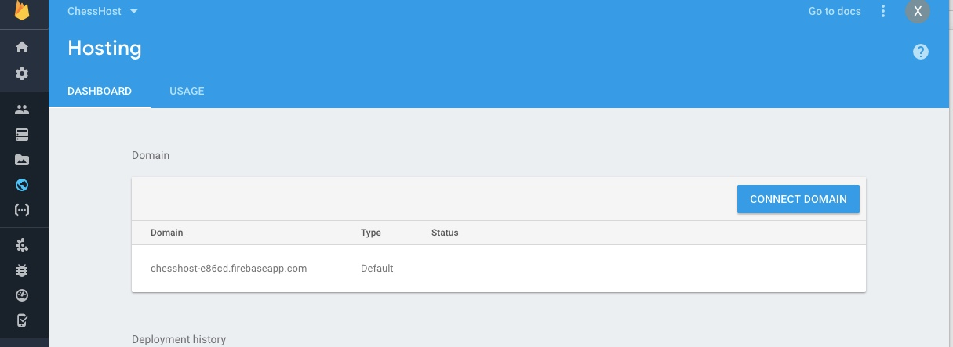
Hosting
Can be visited by mobile devices

Slide 8
References
https://medium.freecodecamp.org/simple-chess-ai-step-by-step-1d55a9266977
My Github: https://github.com/RockSoda/chessgame

